Slide 1
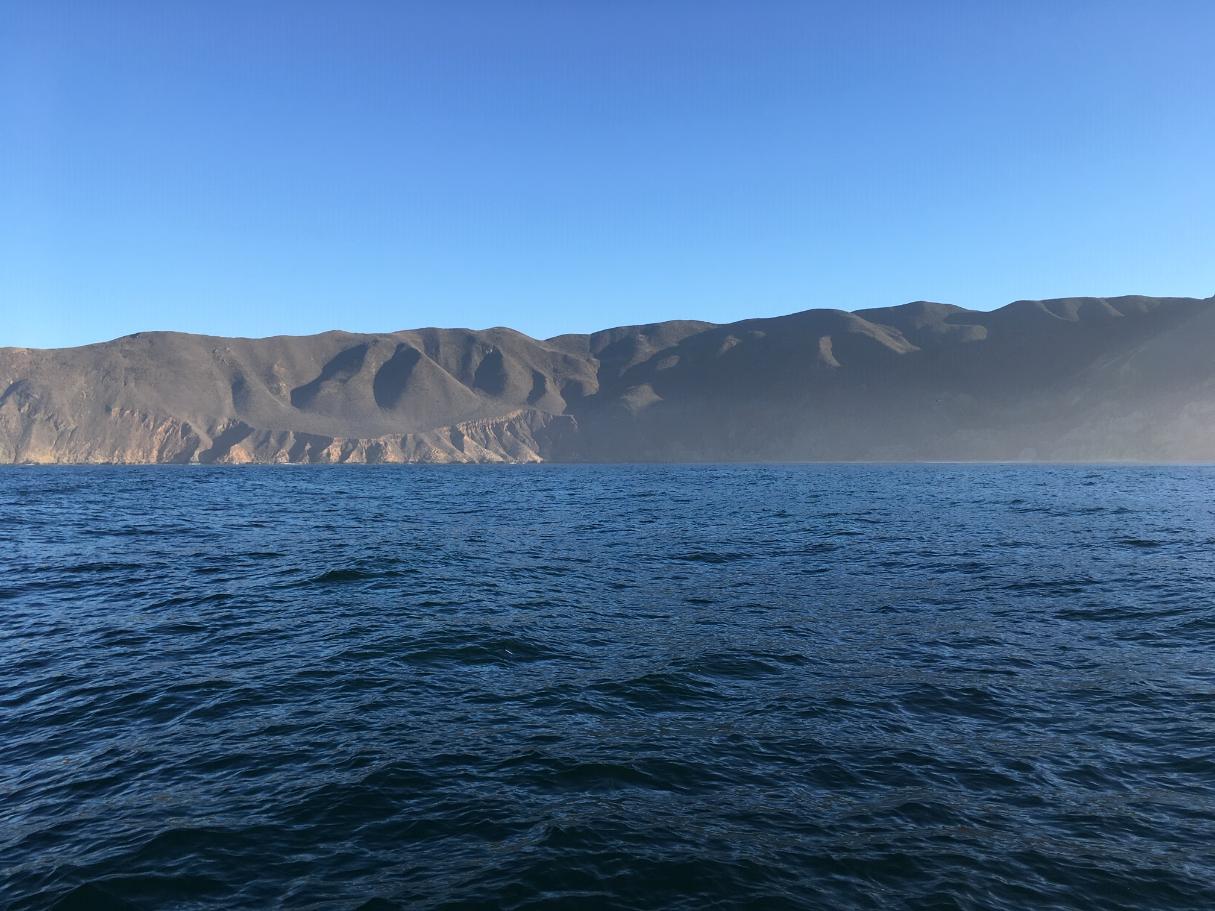

Observations of acoustic intensity fluctuations and ambient noise near the surf zone
Kaus Raghukumar
Kara Scheu
Integral Consulting Inc.
IQOE Workshop Workshop on Low‐Cost, Self‐contained Underwater Acoustic Recording Systems

Slide 2
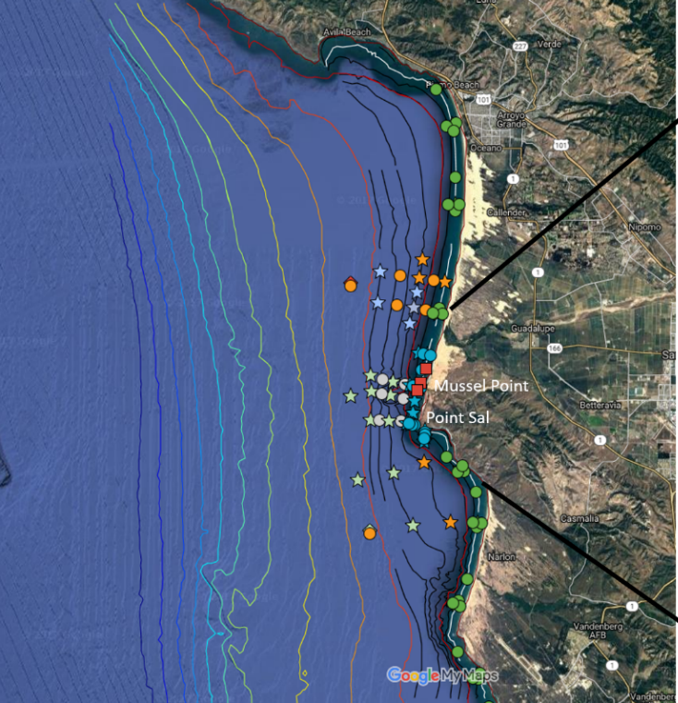
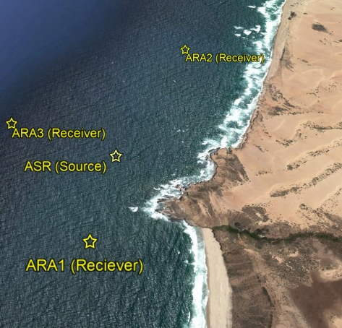
Inner Shelf Direct Research Initiative 2017

Slide 3
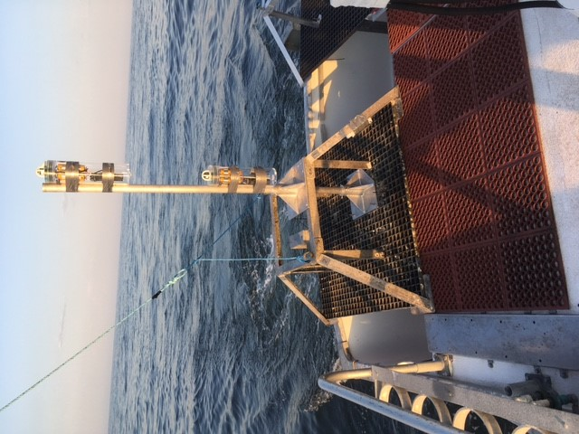
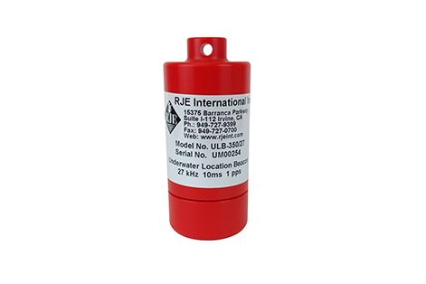
Motivation
  Inner Shelf DRI 2017: physical oceanographic processes from surf zone to inner shelf
  Alongshore measurements of high frequency (27 kHz) acoustic variability during the ISDRI experiment
  Acoustic transmission loss near surf zone
  Alongshore and cross-shore ambient noise measurements
  Ambient noise anisotropy
Acoustic
recorders

Slide 4
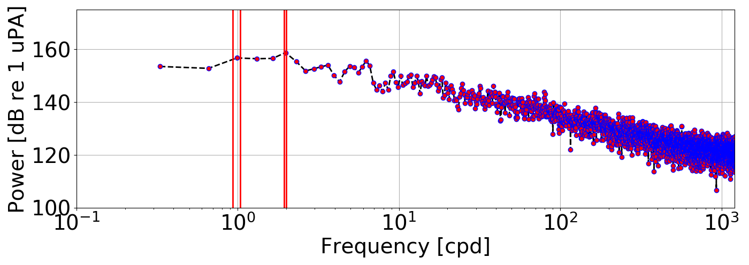
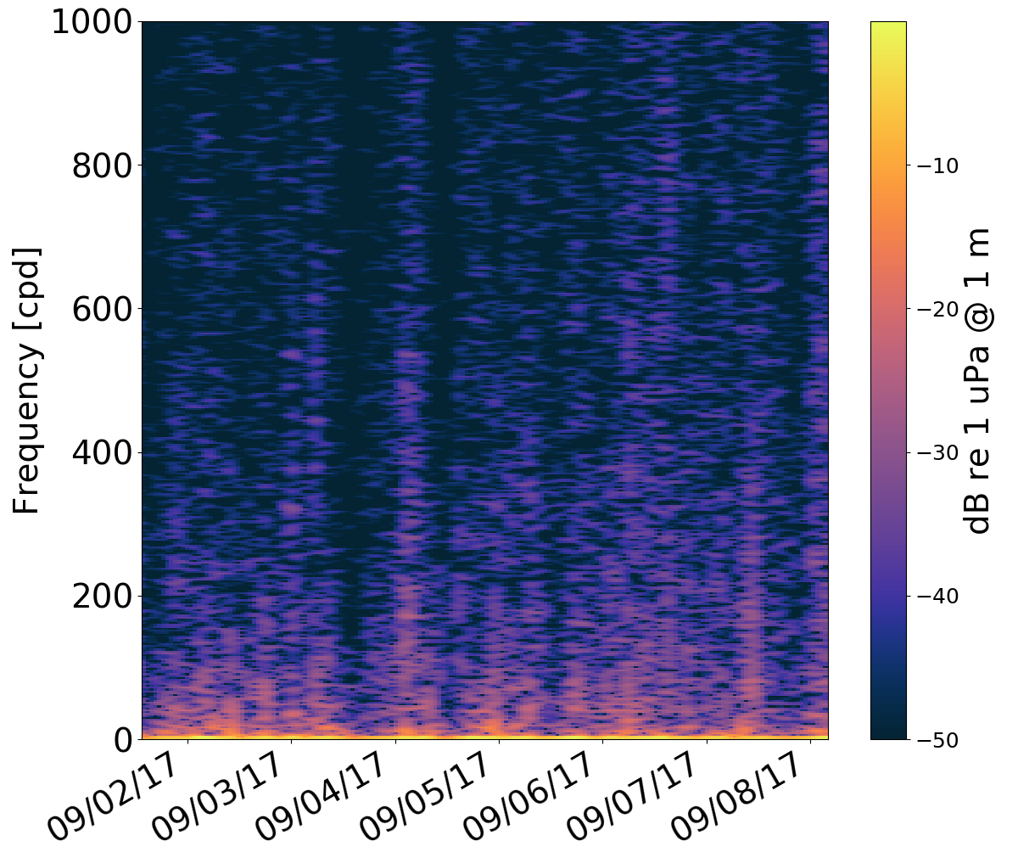
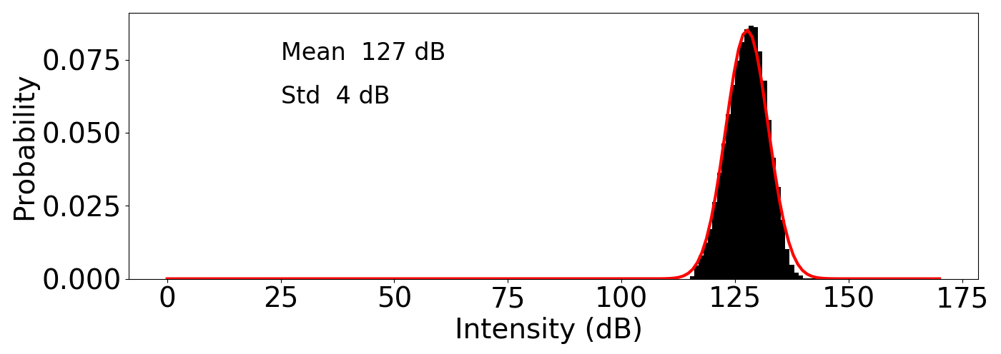
Fluctuation spectra
Intensity
[dB re 1 uPA/Hz]
K1
O1
M2
S2

Slide 5
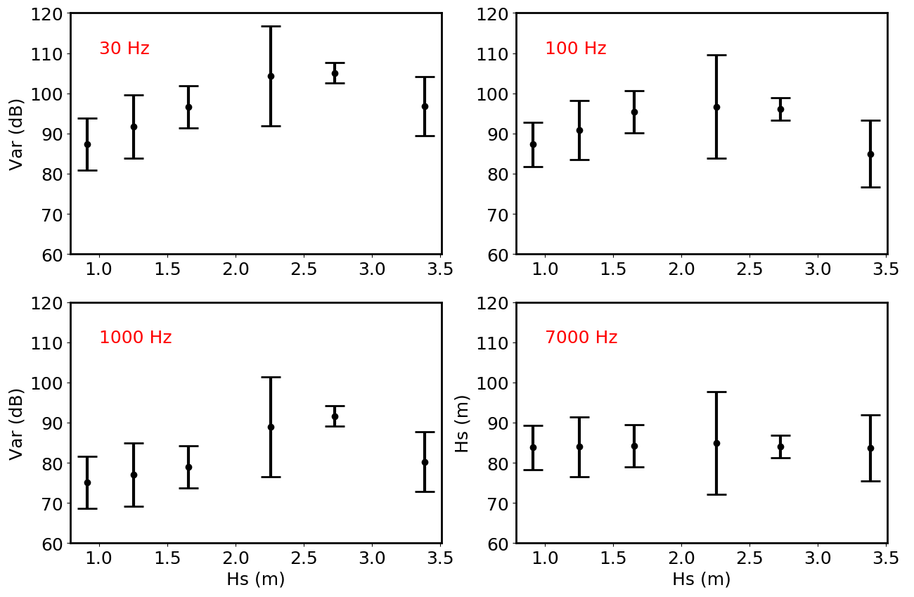
Noise variability with wave height

Slide 6
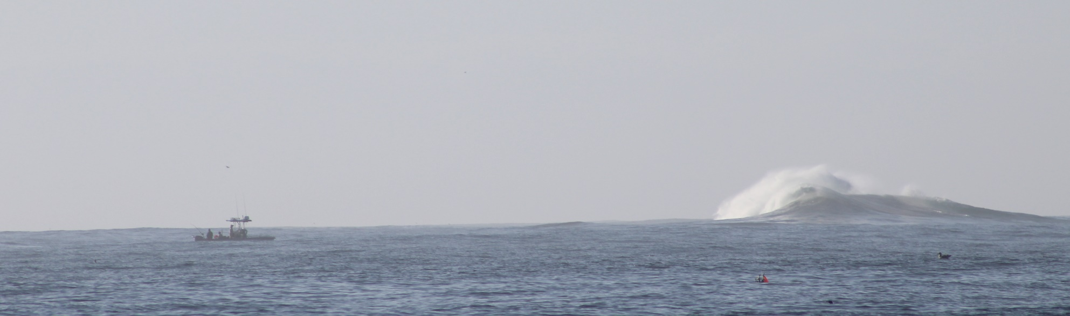
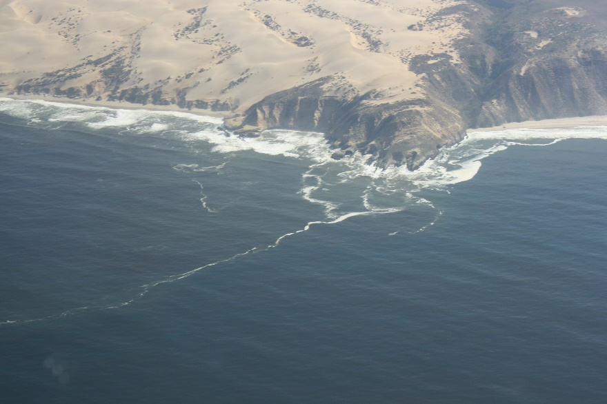
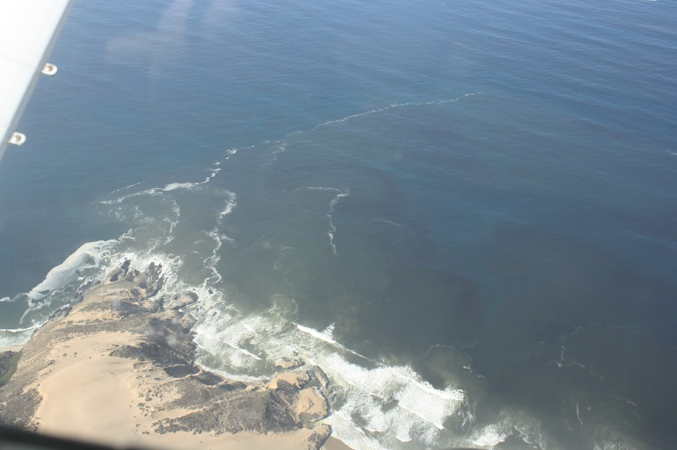
Waves and bubbles
Courtesy Falk Feddersen
Courtesy Melissa Moulton
Courtesy Melissa Moulton

Slide 7
Conclusions & Future Work
Acoustic variability seen at 500 m dominated by diurnal and semi-diurnal tidal components
Ambient noise floor at low frequencies strongly influenced by breaking waves
To relate the higher frequency variability to internal wave measurements by ADCPs and thermistor chains.
Characterization of bubble distributions

Slide 8
Acknowledgements
ONR for support
John Colosi, Chris Miller, Jamie MacMahan at NPS
Skipper and deckhand at F/V Bonnie Marietta

